Slide 1
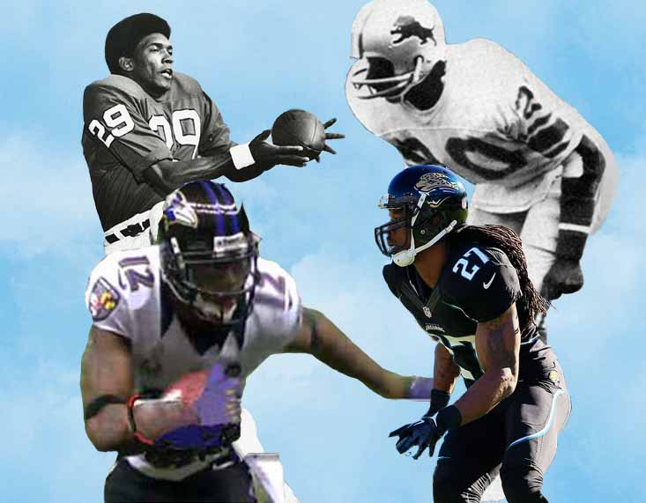
This Month
in
Black College Sports
January 2023

Slide 2
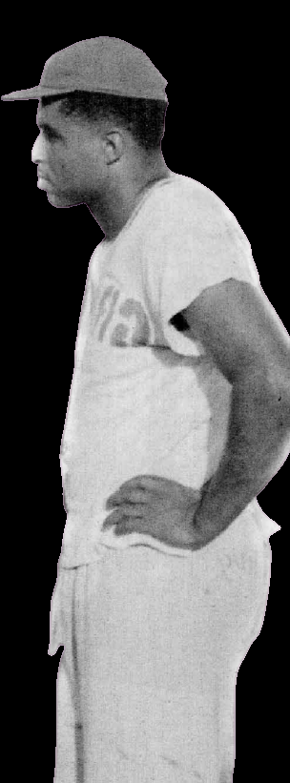
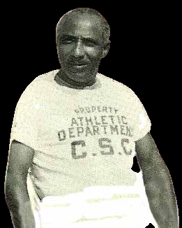
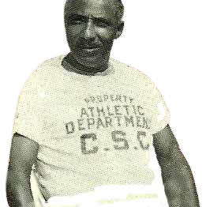
Jan 1, 1948
Vulcan Bowl
Wilberforce defeated the Grambling Tigers, 27 - 21.
The Green Wave (9-1-1), under head coach Gaston F. “Country” Lewis went on to win their first and only Black College National Football Championship after the victory over Eddie Robinson’s Tigers (11-2).

Slide 3
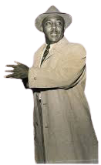

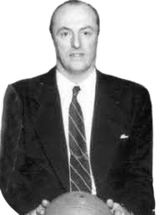
19019011
Jan 12, 1950
Maryland State
Wilberforce defeated the Grambling Tigers, 27 - 21.
The Green Wave (9-1-1), under head coach Gaston F. “Country” Lewis went on to win their first and only Black College National Football Championship with the victory over Eddie Robinson’s Tigers.
…coached by Vernon “Skip” McCain lost to Doggie Julien’s Dartmouth Big Green, 60-59
in the first meeting between
an Ivy League school and a Black College basketball team.

Slide 4


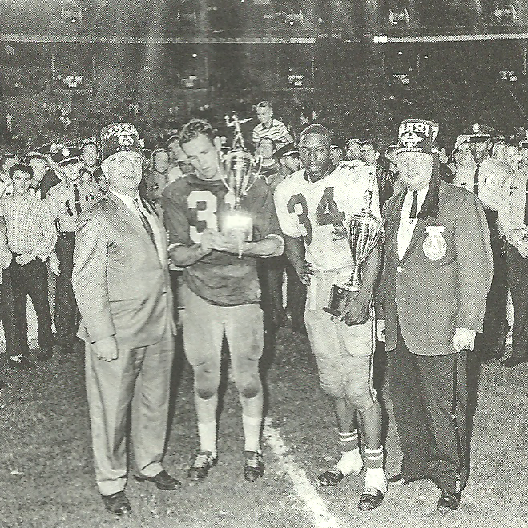



1924
Jan 16, 1956
FIRST INTERRACIAL
BASKETBALL GAMES
FISK Bulldogs
NDSU Bison
held in the South in Nashville, TN…The teams that participated were: FISK, TENNESSEE STATE,
NORTH DAKOTA STATE
and ROCKHURST COLLEGE.
TENNESSEE STATE Tigers
ROCKHURST Hawks

Slide 5
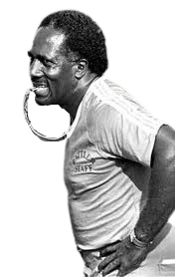
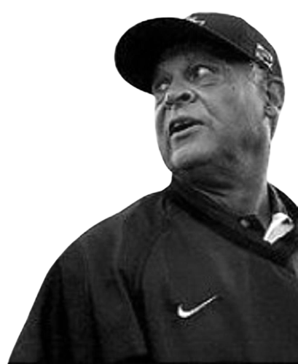
Jan 7, 1978
FIRST ANNUAL
BLACK COLLEGE
ALL-STAR BOWL
The East vs. West in the inaugural showcase of the top talent in Black college football. Rudy Hubbard, who led the Florida A&M Rattlers to the first Div. 1-AA national championship coached the West squad against South Carolina State head coach Willie Jeffries’ East team.

