Slide 1

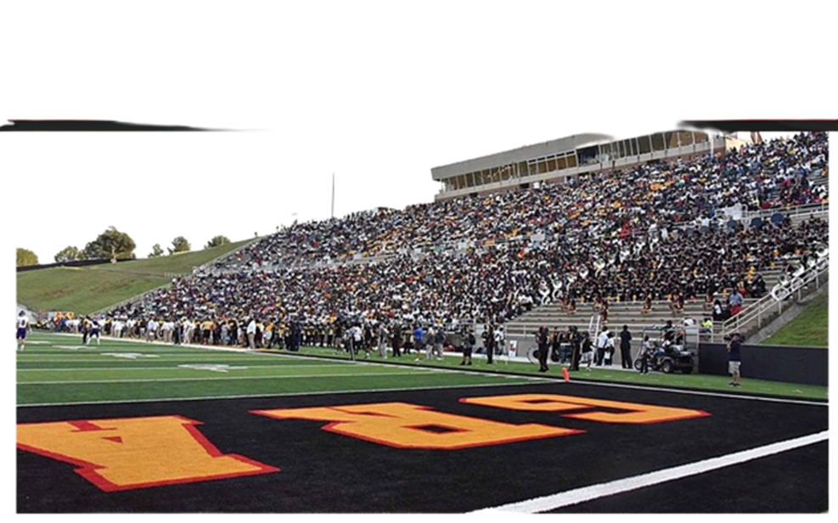

This Month
in
Black College Sports
SEPTEMBER 2023

Slide 2
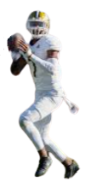
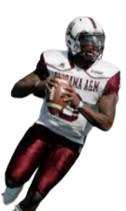
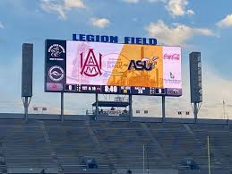
1924
MCC
MAGIC CITY CLASSIC
Drayton Florence, DB
One of the oldest Black college football games pitted rivals Alabama State University and Alabama A&M University. The final score of the inaugural game: Ala. State 30, Ala. A&M 0.
AAM Head Coach: George H. Hobson, First Bulldog coach to win the Classic, 1942
AAM 20 ASU 6
ASU Head Coach: Ralph Harris, First ASU coach to win the Classic
1924
ASU 30 AAM 0

Slide 3
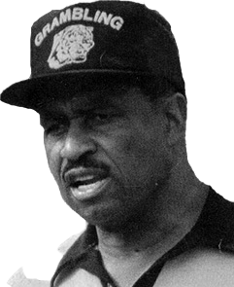
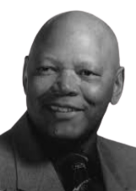
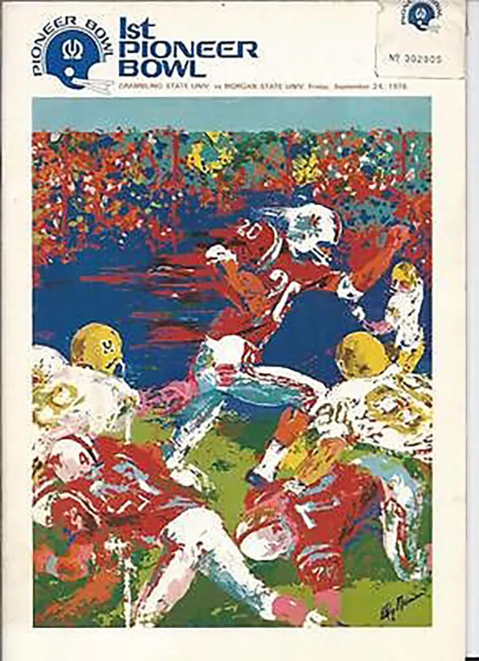
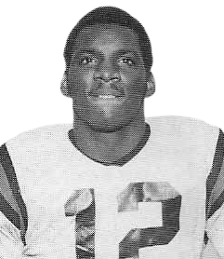
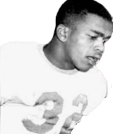
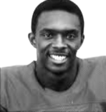

1976
Tokyo Bowl
THE PIONEER BOWL
Drayton Florence, DB
CLEVE ABBOTT
The Grambling State Tigers and the Morgan State Golden Bears played in what was dubbed the Toyko Bowl in Japan as part of the US Bicentennial. The Tigers, coached by Hall of Fame coach Eddie Robinson defeated the Bears led by Henry Lattimore, 42-16.
HC Eddie Robinson
QB Doug Williams
WR Sammy White
HC Hank Lattimore
DE Elvis Franks
WR Bobby Hammonds

Slide 4
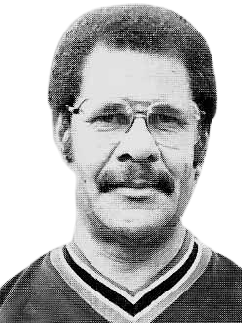
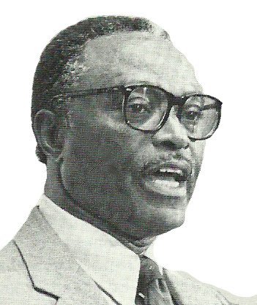
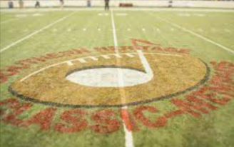
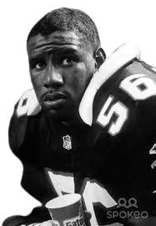
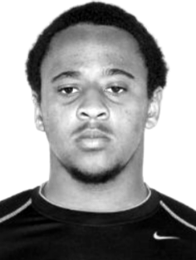
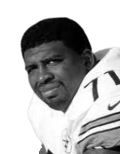
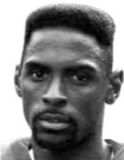
1990
SHC
Southern Heritage Classic
Jackson State University and Tennessee State University played in the inaugural game in Memphis, TN at the Simmons Bank Liberty Stadium. The Tigers of TSU defeated JSU,
23-14.
HC Joe Gilliam, Sr.
CB Anthony Shelton
DL Larry Tharpe
HC W.C. Gordon
LB Darion Connor
WR Tim Barnett

Slide 5
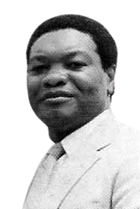
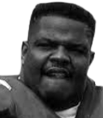
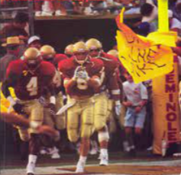
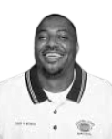
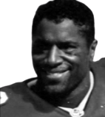
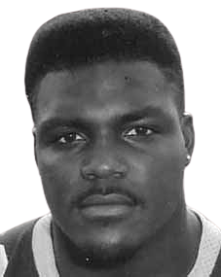
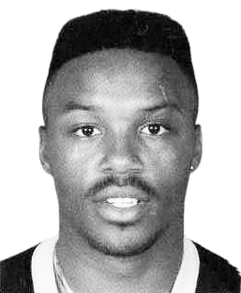
1990
CSUO
Drayton Florence, DB
CENTRAL STATE, OHIO
The Marauders won their first NAIA National football Championship led by head coach BILLY JOE. The no. 2 ranked Marauders defeated the Mesa State Mavericks in the Champion Bowl, 38–16 after winning all three games on the road. They repeated in 1992.
HC Billy Joe
QB Henderson Moseley
DB Vince Buck
OL Eric Williams
LB Marvin Coleman
LB Marvin Pope

Slide 6
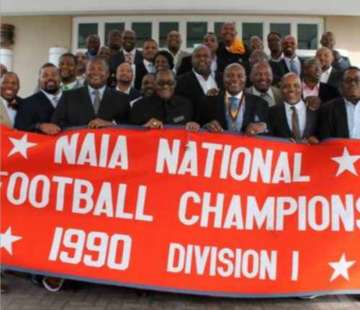
Come Celebrate
More
BLACK COLLEGE HISTORY
&
LEGENDS!

