Slide 1

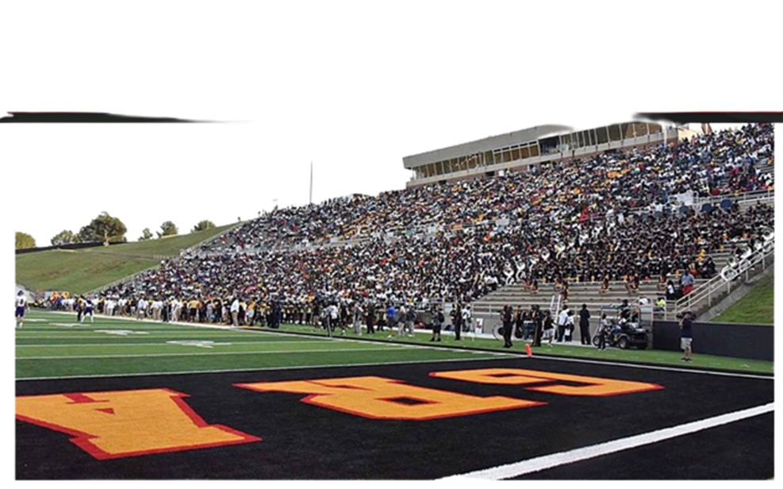

This Month
in
Black College Sports
OCTOBER 2023

Slide 2
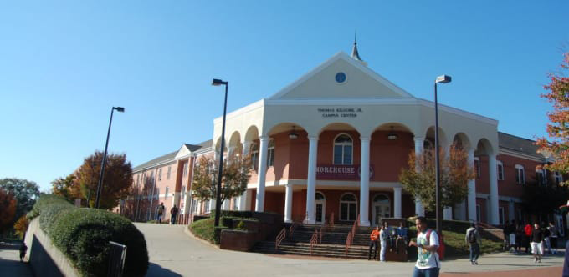
Notable Alumni:
Dr. Martin L. King
(Civil Rights)
Edwin Moses
(Track & Field)
Donn Clendenon
(Baseball)
Harold Ellis
(Basketball)
Morehouse College founded as Augusta College in the basement of Springfield Baptist Church in Augusta, Georgia and relocated in Atlanta in 1879.
1867

Slide 3

Notable Alumni:
Walter Payton
(football)
Lem Barney
(Football)
Robert Brazile
(Football)
Jackie Slater
(Football)
Natchez Seminary (Jackson State University) was founded by the American Baptist Home Mission Society of New York and moved to Jackson, MS in 1882, and renamed Jackson College.
1877

Slide 4
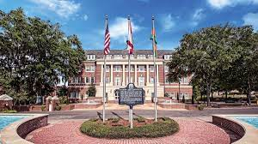
Notable Alumni:
Bob Hayes
(Football)
Althea Gibson
(Tennis)
Ken Riley
(Football)
Fred Humphries
(President)
Willie Galimore
Football
Natalie White
(Basketball)
Founded as the State Normal College for Colored Students. In 1953, the name was officially changed to Florida Agricultural and Mechanical University. It is the only Black college or university to win a national college football championship in the NCAA.
1887

Slide 5
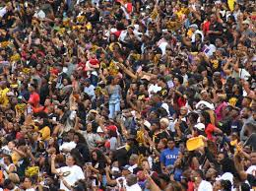


Wiley Wildcats
Langston Lions
The State Fair Classic The first game was played on Monday, October 19 and featured the Wiley College Wildcats and Langston University Lions.
They played to a 0–0 tie before a crowd of 5,000.
1925

Slide 6
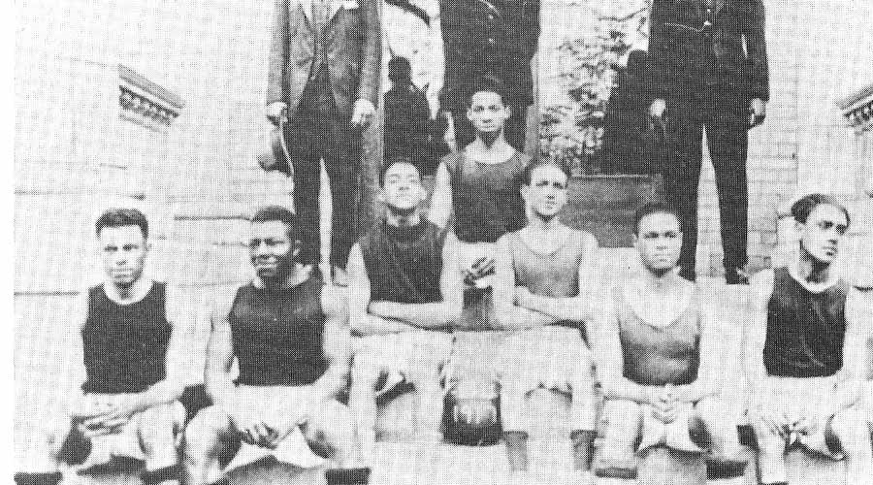
Notable Alumni:
Fred “Curly” Neal
(Basketball)
Eddie McGirt
(Head Coach)
Vince Matthews
(Track & Field)
Jethro Pugh
(Football)
1928
Johnson C. Smith University organized its First Men’s Basketball Team

Slide 7
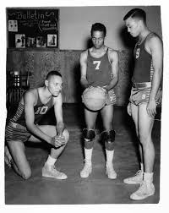
NAIA Champions:
Tennessee A&I (State)
(1957,58,59)
Grambling
(1961)
Prairie View A&M
(1962)
Central State, Ohio
(1965,68)
Kentucky State
(1970,71,72)
Coppin State
(1976)
Texas Southern
(1977)
1950
First All-Black District 29 organized by the NAIA in
the first step towards breaking the color barrier in college basketball
1953
Tennessee A&I , led by head coach Clarence Cash entered the NAIA National Tournament as the first Black college from the District 29 All-Black district
First National college organization to allow Black colleges to participate in a national basketball championship tournament
NAIA

Slide 8
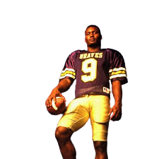
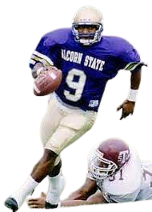
The Breakout Game
Career Highlights:
National Player of the Year
Set NCAA all-time Career Passing 13, 487 yards
AP NFL MVP
Walter Payton Award
Tenn. Titans Ring of Honor
October 22 Steve McNair made his college freshman debut. He led Alcorn State to a thrilling come from behind upset of the Grambling Tigers, 27-22. He went on to become a three-time All-American and National Player of the Year in his senior year. He set NCAA all-time Career Passing record with 13, 487 yards. McNair was the first Black quarterback to win the AP NFL MVP . He is enshrined in the College Football Hall of Fame.
1994

Slide 9
Celebrate
More
BLACK COLLEGE HISTORY
&
LEGENDS!

