Slide 1
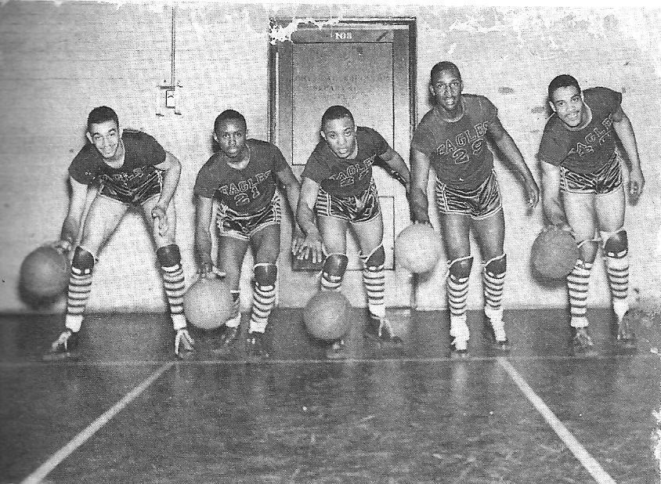
This Month
in
BLACK COLLEGE SPORTS HISTORY
1837 CHEYNEY STATE University was founded by Richard Humphreys as the African Institute. It is the oldest HBCU.
1845 ATLANTA BAPTIST SEMINARY played one of the first organized baseball games at a Black college.
1922 FIRST CIAA TRACK & FIELD MEET was held at Hampton Institute, who won the first three meets.
1940 NAIA (aka the NAIA) held their first national tournament in Kansas City, MO. Nineteen years later, Tennessee State A&I became the first Black college to win a national basketball championship (1957).
1941 (March 22) North CAROLINA COLLEGE for NEGROES (North Carolina Central University) played four games in one day during an end-of-season men's basketball tournament in Cincinnati, Ohio NAIA District .
1943 THE “SECRET GAME” between North Carolina College (coached by John B. McLendon, Jr.) and Duke University. In the first interracial collegiate matchup played in the South, NCC overwhelmed the Blue Devils, 88-44.

